Slide 1
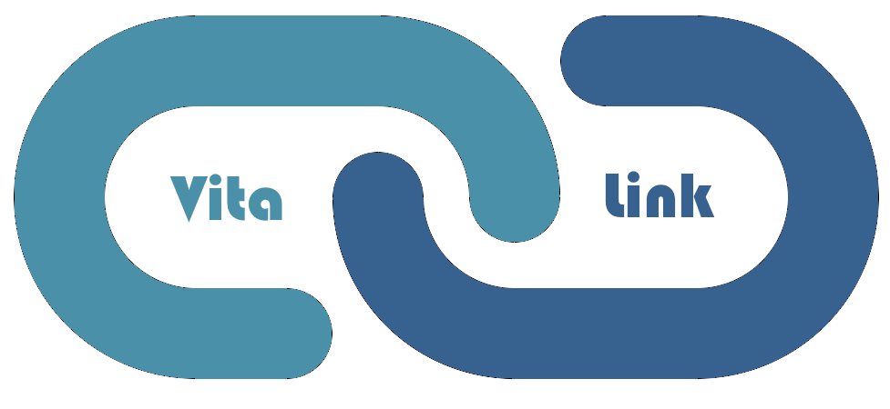
Cinco Suavez
Kyle King Arielle Bitton Ashley Miller Luka Zhuppa
Notes:
Kyle - We are VitaLink, a new approach to patient-doctor communication

Slide 2
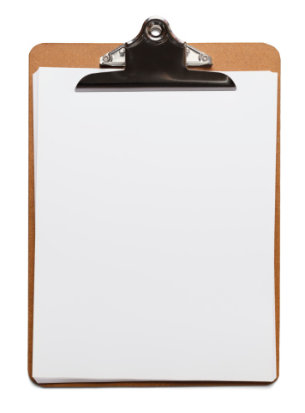
Contents
Skit
Aim and Core Values
Product Vision - Wireframe
Dimensional Analysis
Strategy Canvas
Implications
Product Demonstration
Questions
Notes:
Kyle

Slide 3
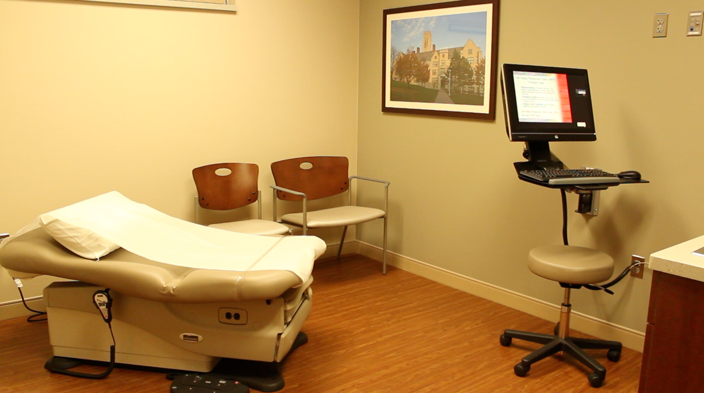
s k i t.
Notes:
Arielle: Patient
Luka: Doctor

Slide 4




Aim
Notes:
Patient Health -- Patient-Doctor Relationship -- Open Dialogue
*Through an app
Luka: At the very core of what we wanted to come up on this journey to make the health industry more effective. We honed in on three core values. At the very top, and very obviously is patient health. Whatever, path we take our purpose is to ensure that there health is our number one concern.
To capture that value we also wanted have a value in building potential relationship between patient and doctor. ….
Next to open dialogue. In order, to create those...

Slide 5
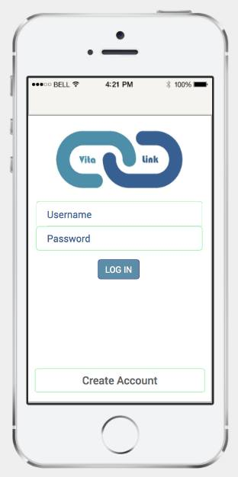
Notes:
Arielle
We really believe we created a solution that will transform the communication system between a patient and their doctor.
Let’s step back to when my character was in the doctor’s office for the second time because she did not initially follow her treatment plan directly . what if she had Vitalink her first time treating her strep throat. Well let’s see
Create a system that will enhance communication between patient and doctor to ultimately optimize the patient’s health.
Patient Centric Solution
Easily Accessible Information
Minimal Effort to Use
Ensure long-term health:
Maintenance, successfully taking care of acute issues, to ensure long-term health.
Our realization is that the most critical time where a patient’s health is determined is while outside the doctor’s office.
Both the doctor and the patient have to be equally invested.
Communication relies on the flow of data.
We originally looked at wearables, etc.
Find ways to keep a communication loop interactive.
Provide info on what the patient is doing outside of the office.
-We realized that health maintenance and successfully addressing short-term health issues is necessary to long-term health.
-That is why we decided to think of a system that involves the physician, since that is our primary way of maintaining our health and resolving acute health conditions
-We considered other alternatives (like
Gathering information that takes place outside of the office so the doctor has to gather less information during the appointment - we considered using wearables, self-test machines for patients outside the appointment, and ways that the patient can record their health information while they are away from the doctor → although that would leave more time in the appointment for face-to-face interaction and communication, and give the doctor more timely collected data, the main benefit of such a system would be efficiency.
So we wanted to get closer to the problem…
Where does it all start?
Wireframe
Assumptions
What if a doctor could predict a patient’s symptoms?
Reaction to medication? Side effects?
What if a patient understood everything from a doctor’s appointment?
etc?

Slide 6
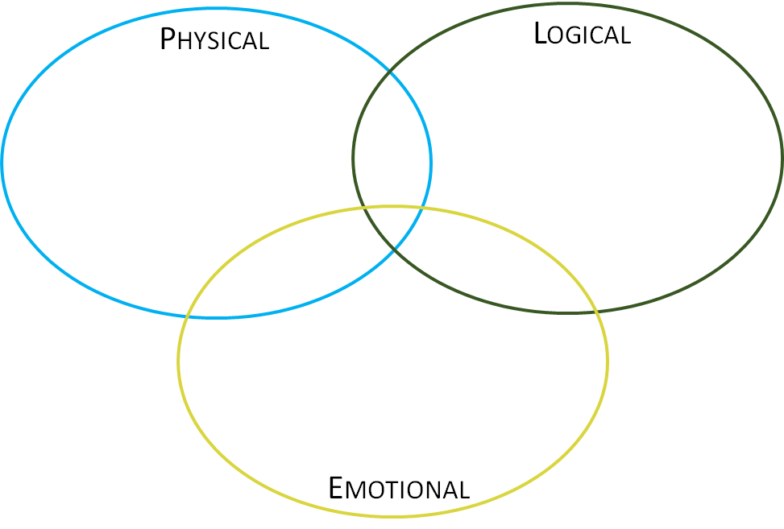
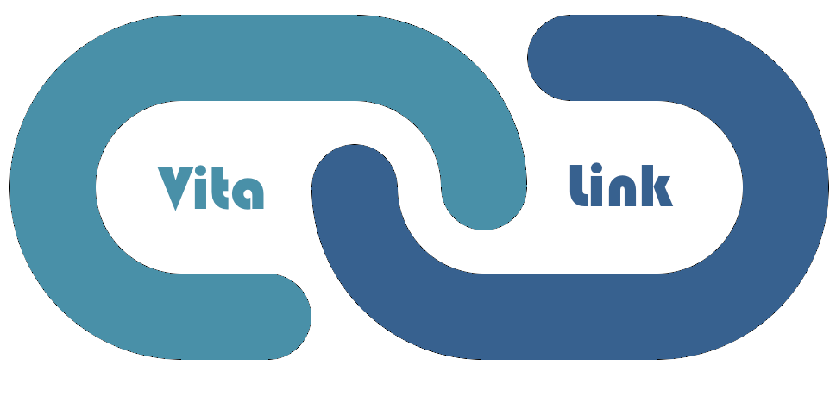
Interactive Treatment Plan
Monitor progress through tracking symptoms
Becoming healthier
Plan created by the patient’s physician
Future health benefits
Symptom checkpoints
….
Builds Trust
Feeling Healthy
Optimism about future health
Feeling Secure
Notes:
We really designed a product that connects the physical, logical, and emotional dimensions.
The interactive treatment plan allows the patient to become and stay physicially healthier
Using this also makes sense to the patient because the plan is created by a professional, and the symptom checkpoints lowers the risk of the adverse affects of misdiagnosis
Lastly, by using Vitalink, patients can feel more secure about their health and create a meaningful trusting relationship with their physician.

Slide 7
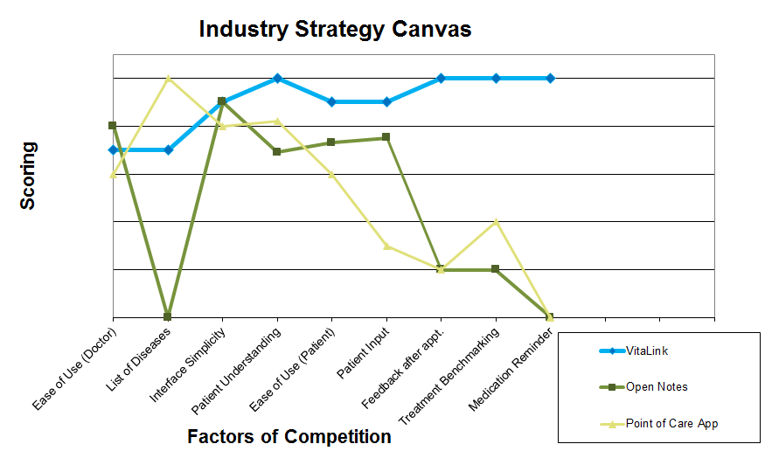
Notes:
Point of Care App
provides videos and diagrams to supplement the treatment plan and help the presentation better understand their sickness
Open notes provides a platform that allows the doctor to share the notes that they took during the appointment with the patient.
Our app combines interactivity, the sharability of information, with other characteristics that create a blue ocean.
OpenNotes

Slide 8
What implications would arise if we introduced a system in which the patient has access to an interactive treatment plan created by the physician for their use outside of the doctor's office?

Slide 9

Positive Implications
Doctor’s time is better utilized.
+4/6
Patients will be able to understand their treatment plan and required actions.
+5/6
Patients will be able to successfully follow advised treatment.
+5/7
Patients will decrease their use of Emergency Health Services. +50/5
Notes:
Ashley

Slide 10
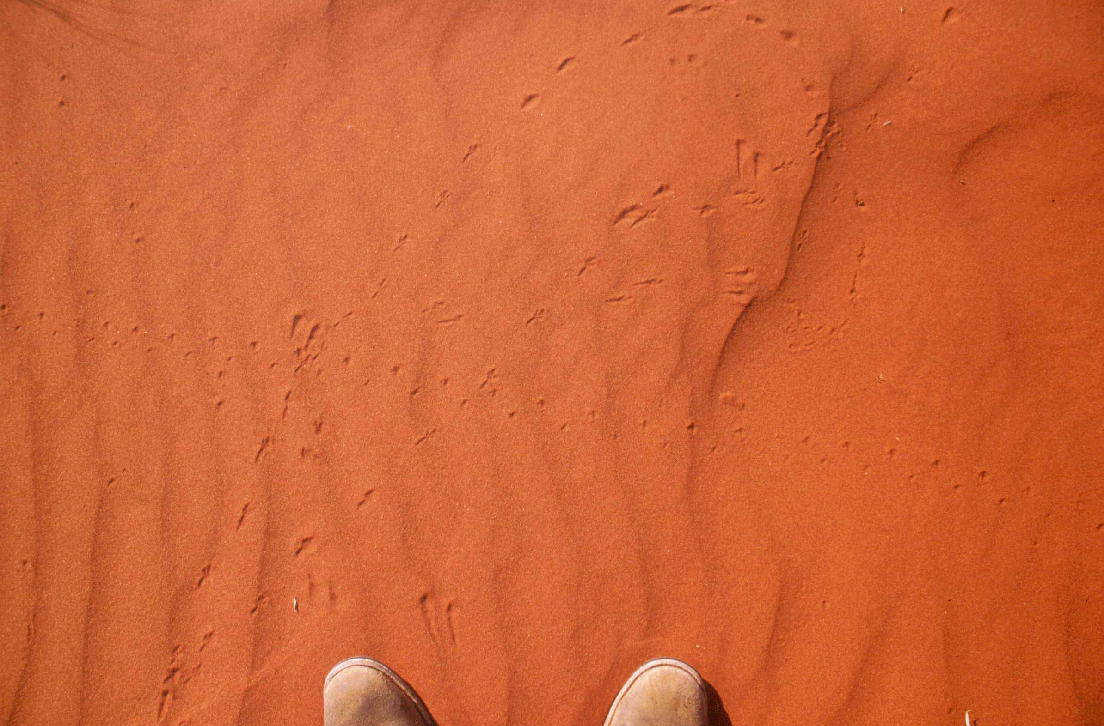
Negative Implications
Commun-
ication does not improve.
-5/8
Doctor’s will to put more effort in creating a treatment plan.
-3/6
Doctors will stop utilizing VitaLink.
-4/7
Patients will continue to have ineffective treatment plans.
-5/8
Notes:
Ashley
We thought of the patients throughout this process. But we have to accommodate the doctor. If our product is an inconvenience to use by the doctors, VitaLink will not be utilized. The implications results in communication and treatments being inefficiently and communication is not being improved.
In order to mitigate that problem, we want to reduce the effort required to create a treatment. Doctors will be able to select templates for specific treatment, and edit them according to the patient’s needs. In addition, this treatment plans will be part of a bigger community of doctors. Doctors will be able to create and share treatment plans, that other doctors can view and accomadate to their patient’s needs.

Slide 11
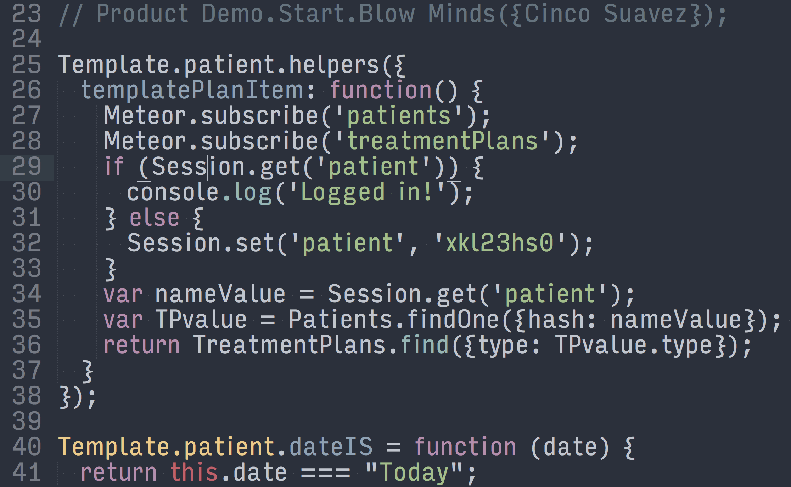
Notes:
Kyle:
Investigate Security Implications
Understand the technical constraints of the system

Slide 12
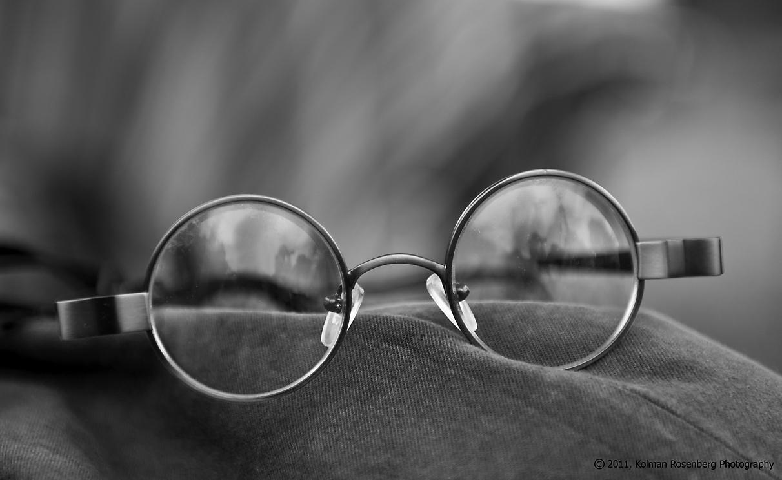
“ Tell me and I’ll forget.
Show me and I might remember.
Involve me and I will understand. ”
Benjamin Franklin
Questions?

Slide 13
Appendix Slides

Slide 14
Supporting Research
Communication breakdowns in the doctor-patient relationship are responsible for more than 80% of medical errors and adverse events.
More than 60% of patients reported doing better with taking medications as prescribed because of open notes.
More than 77% of patients reported that open notes helped them feel more in control of their care.
Up to 80% of medical information provided to patients by healthcare practitioners is forgotten immediately

